Slide 1
Customer Activation Prediction Model Capstone Project
Judith ha
General Assembly – Data Science
February 2019

Slide 2
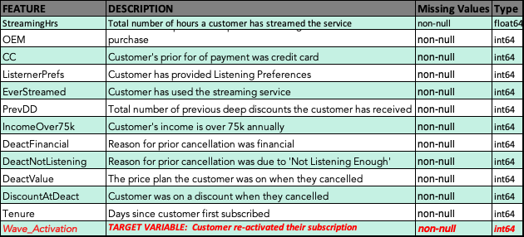
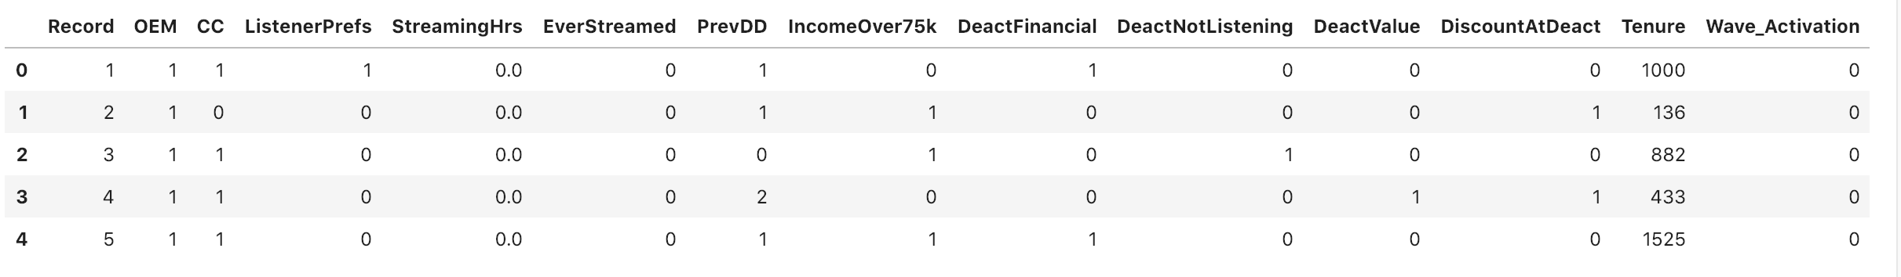
Background
Objective: Develop a predictive model that predicts the probability that a re-engagement opportunity re-activates their subscription.

Slide 3
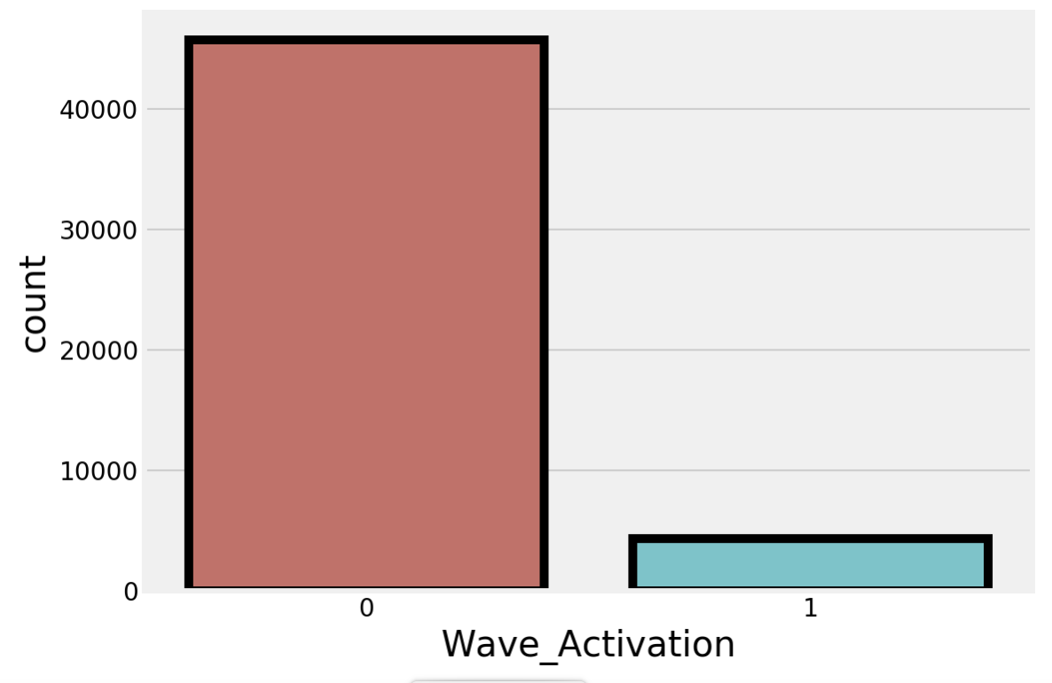
Target Variable
For 50K opportunities, 8.549% reactivated and re-subscribed.
45,703
4,297

Slide 4
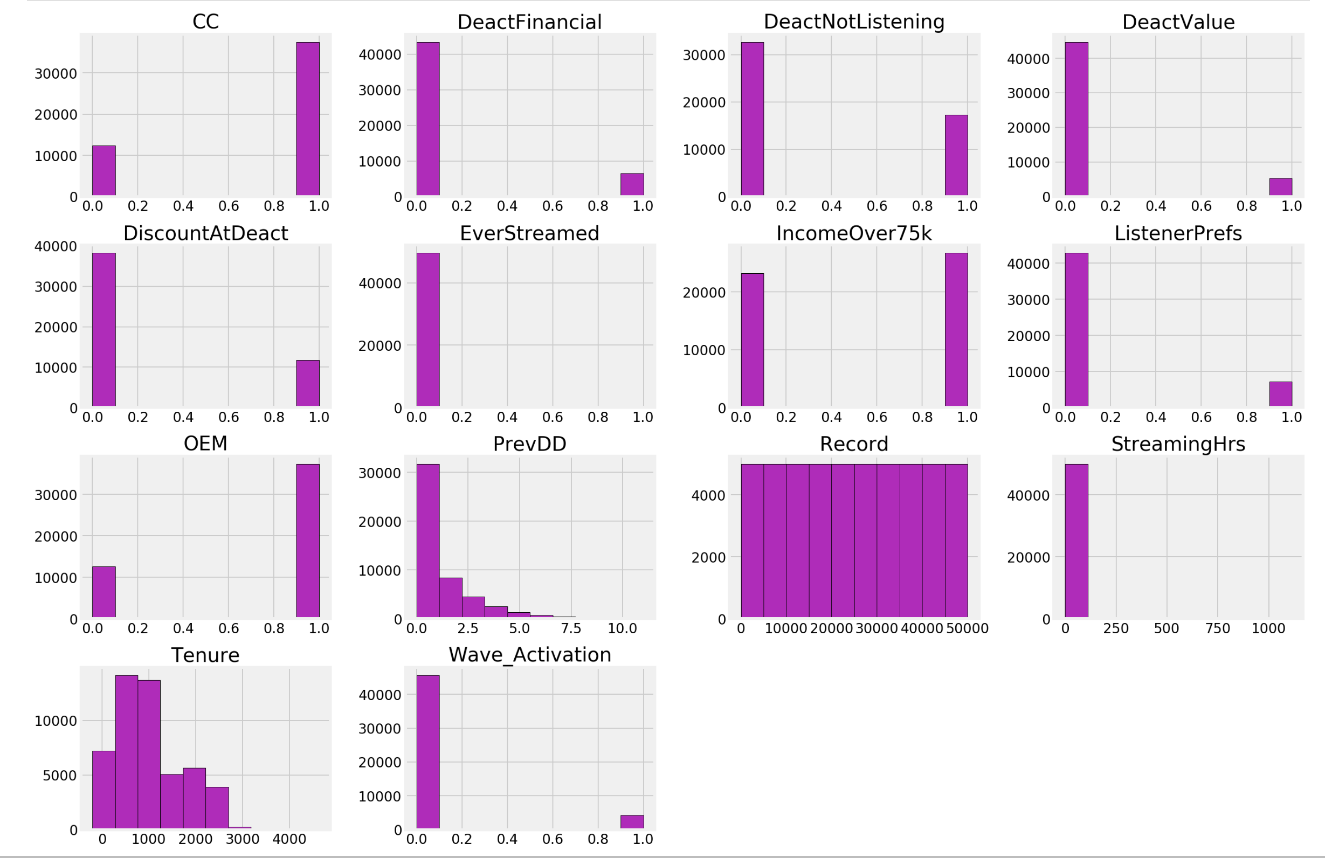
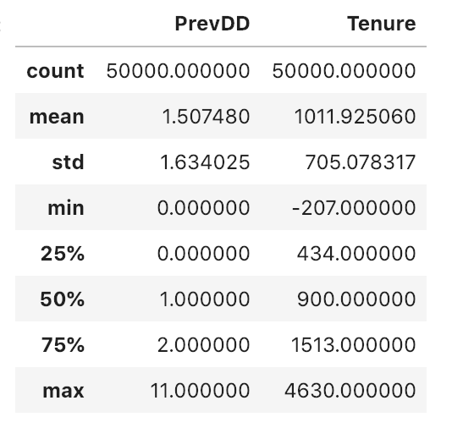
Feature Variable Volumes
11 of the 13 features are binary variables and do not need to be recoded as dummy variables.
Record feature is not a feature it is a record id and can be dropped
Tenure, PrevDD & StreamingHrs are continuous variables.

Slide 5


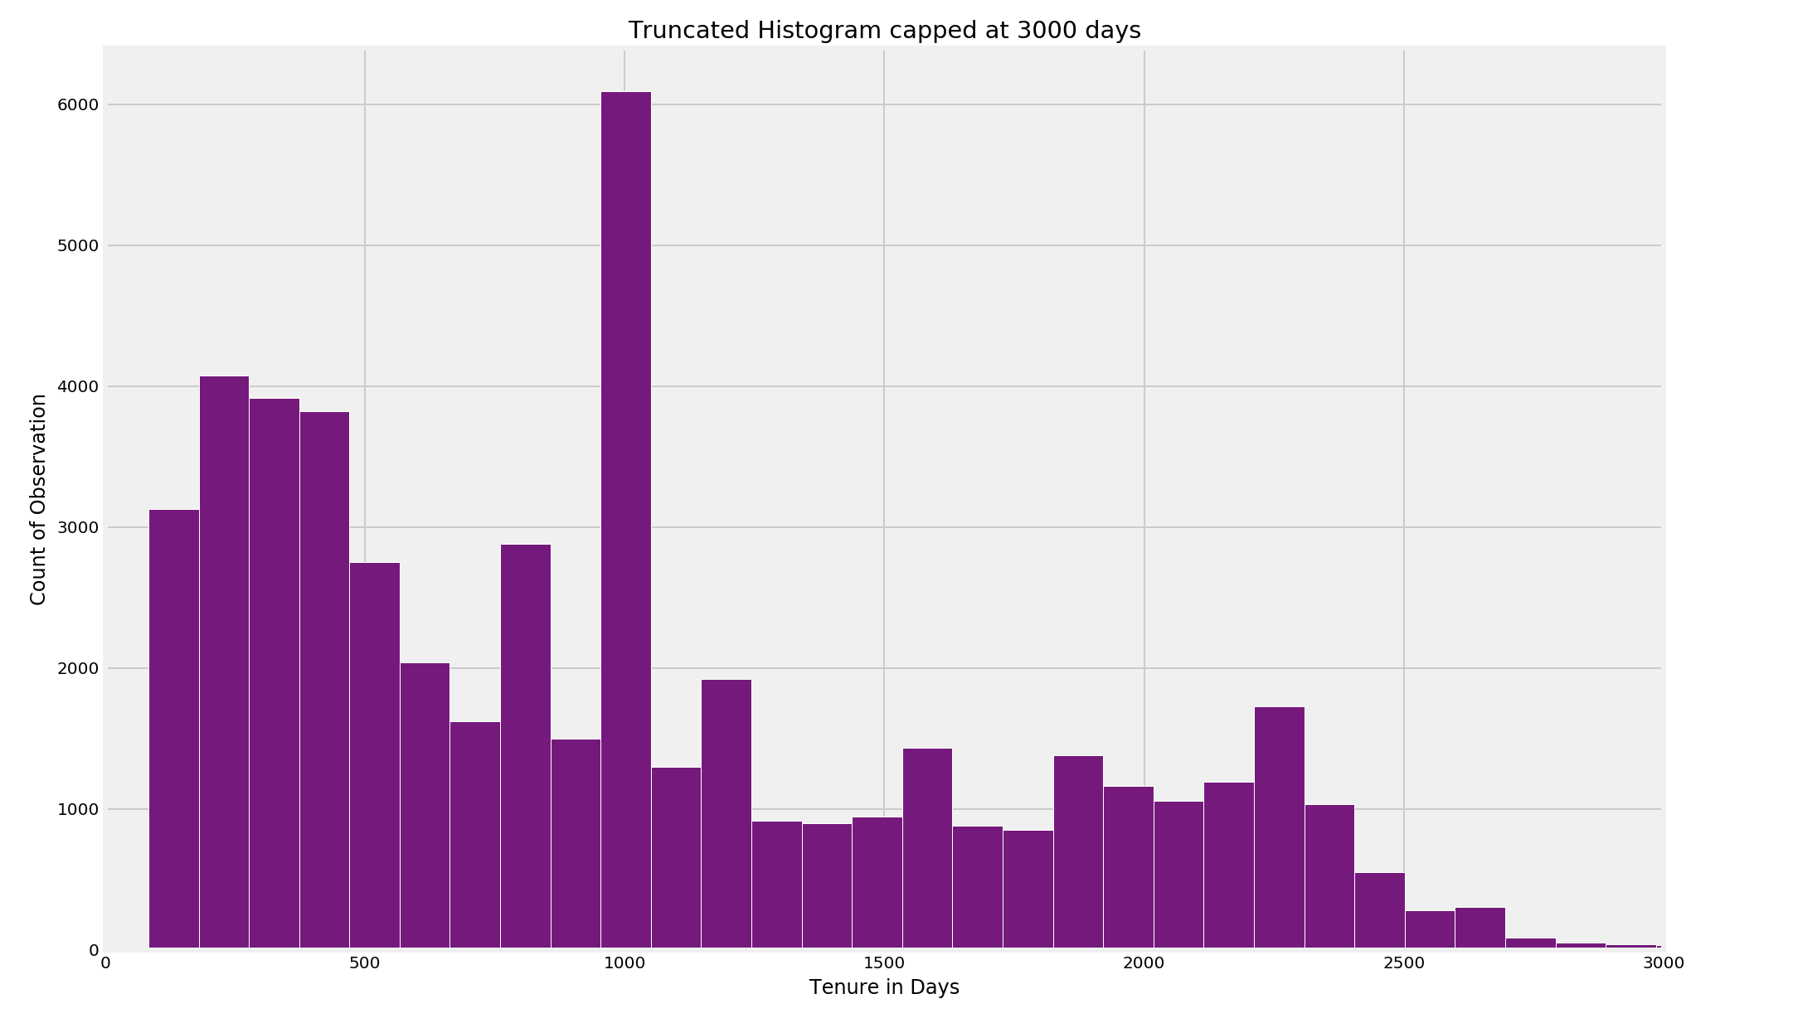


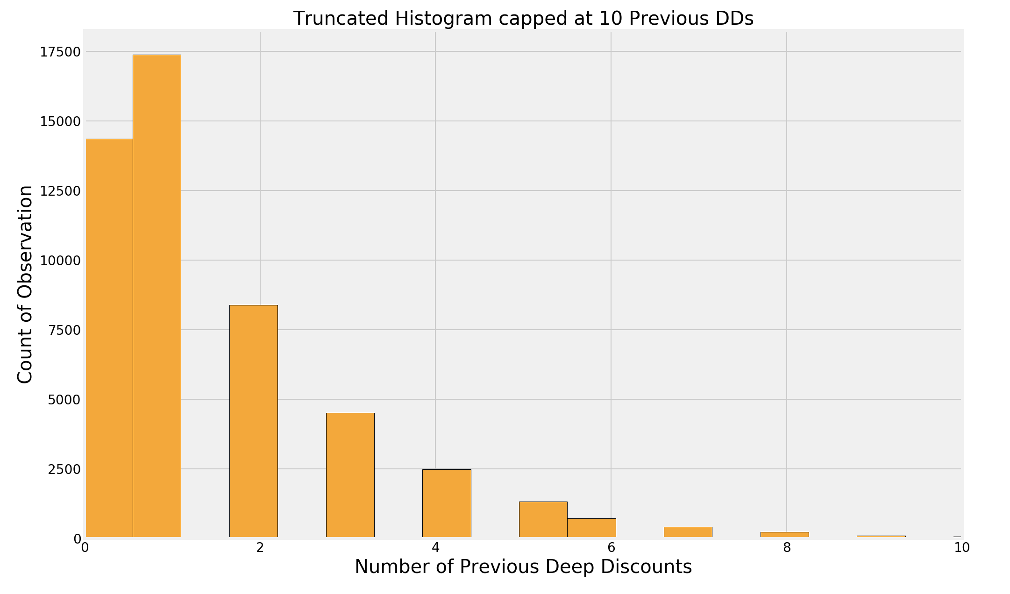

Histograms of numeric features

Slide 6
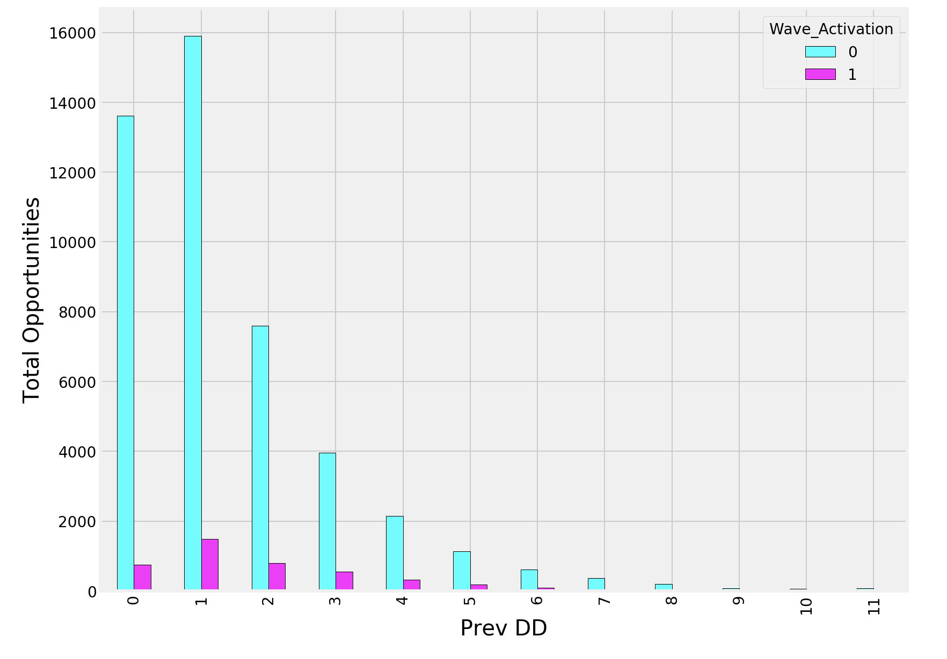
Previous Deep Discounts

Slide 7
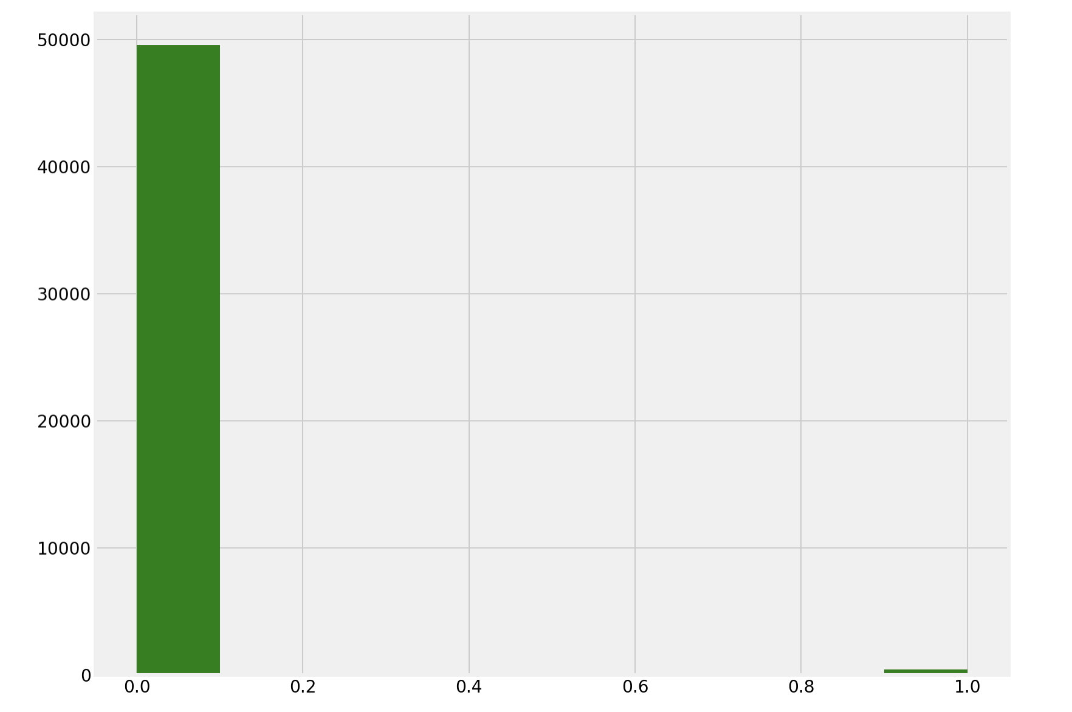
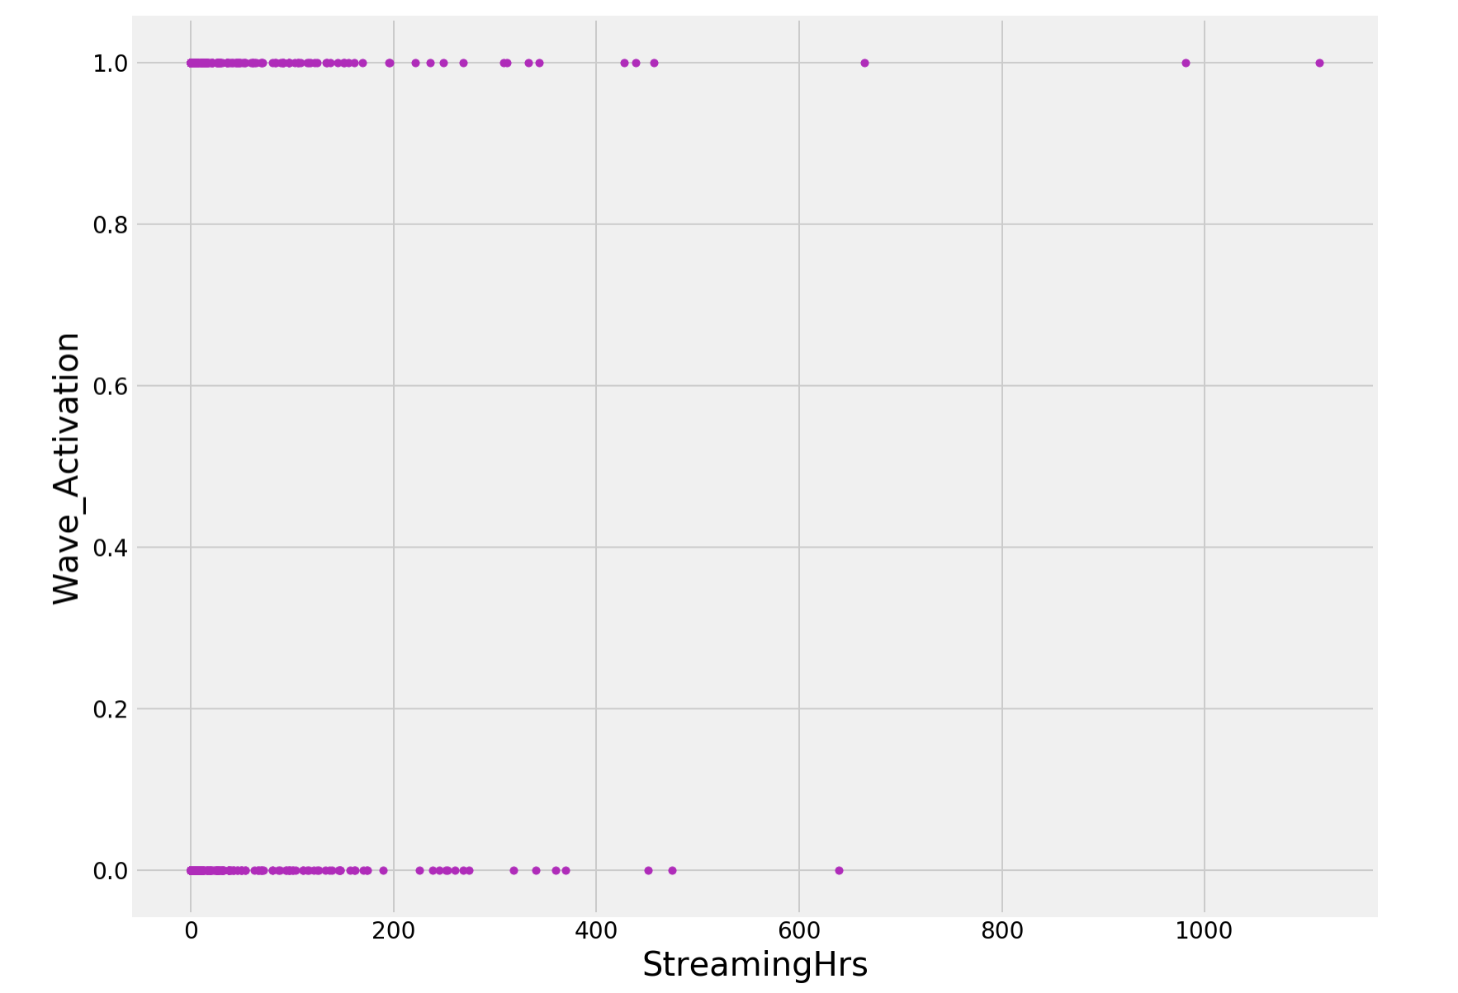
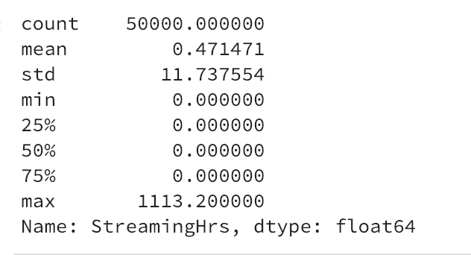
EverStreamed & StreamingHrs
Only 0.838% of the sample has ever streamed
Of the 419 that have streamed, _____ Activated
Amongst all subs, the mean time streamed was 0.471, which is slightly under 30min
49,581
419

Slide 8
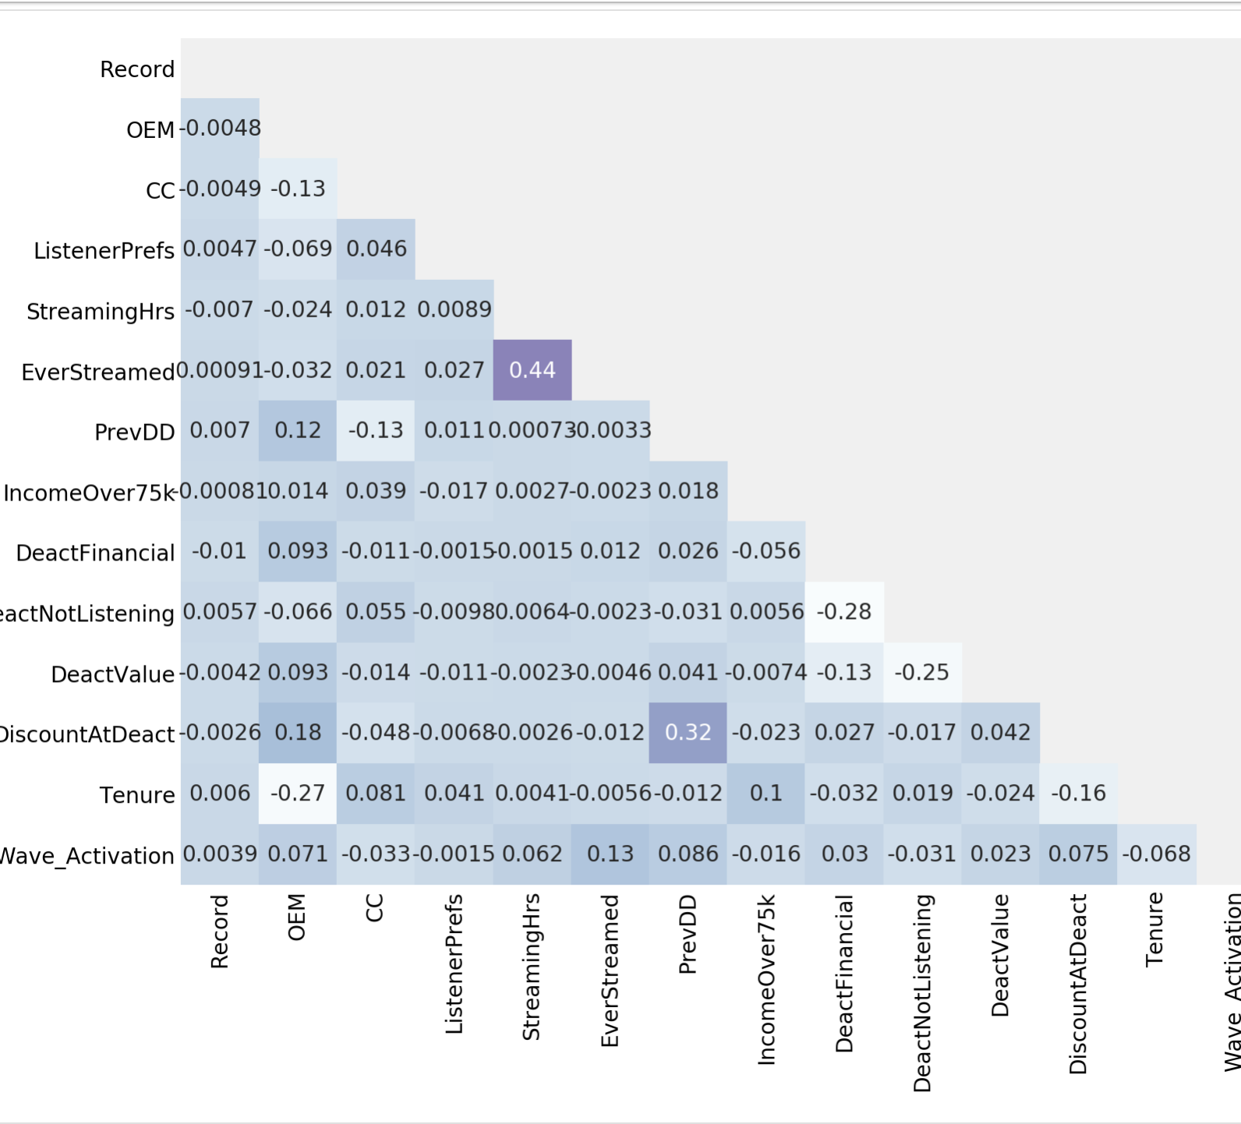
Correlations between features & target
Correlations amongst features are relatively week with the exception of:
EverStreamed & StreamingHrs
DiscountAtDeact & PrevDD
Strongest correlation between target and features is with “Ever Streamed.”

Slide 9
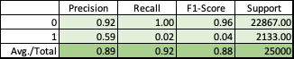
BASELINE MODEL: All observations & all features logistic regression model
P(Wave_Activation) =
-2.6137
+0.4316 * OEM
-0.0626 * CC
+0.0131 * ListernerPrefs
+.0019 * StreamingHrs
+.0021 * EverStreamed
+0.1325 * PrevDD
-0.1126 * IncomeOver75k
+0.2023 * DeactFinancial
-0.1446 * DeactNotListening
+0.0991 * DeactValue
+0.3069 * DiscountAtDeact
-0.0004 * Tenure
AUC=0.65
N=50,000

Slide 10
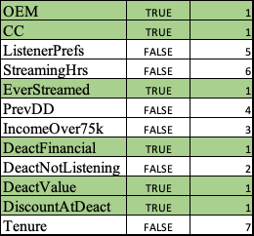
Recursive Feature Elimination:

Slide 11
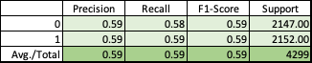
OPTIMIZED MODEL: Randomly sampled non-activators and best features logistic regression model
P(Wave_Activation) =
+0.0900
+0.2407 * OEM
-0.1178 * CC
+0.3698 * EverStreamed
+0.1321 * DeactFinancial
+0.0527 * DeactValue
+0.2726 * DiscountAtDeact
AUC=0.62
N=8,597

Slide 12
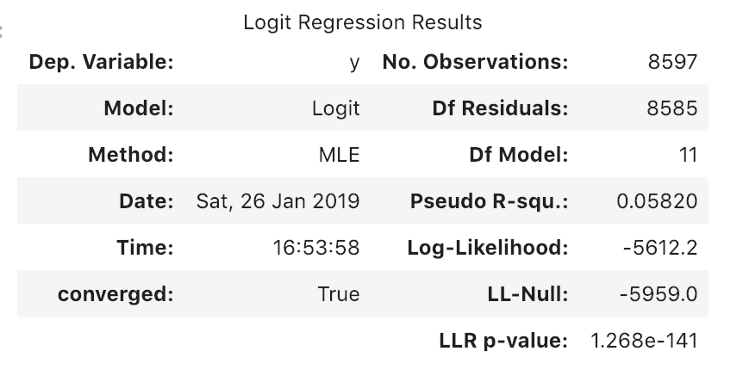
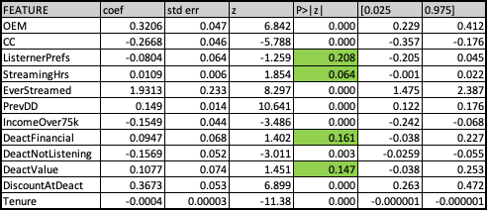
Alternative Method for Feature Selection

Slide 13
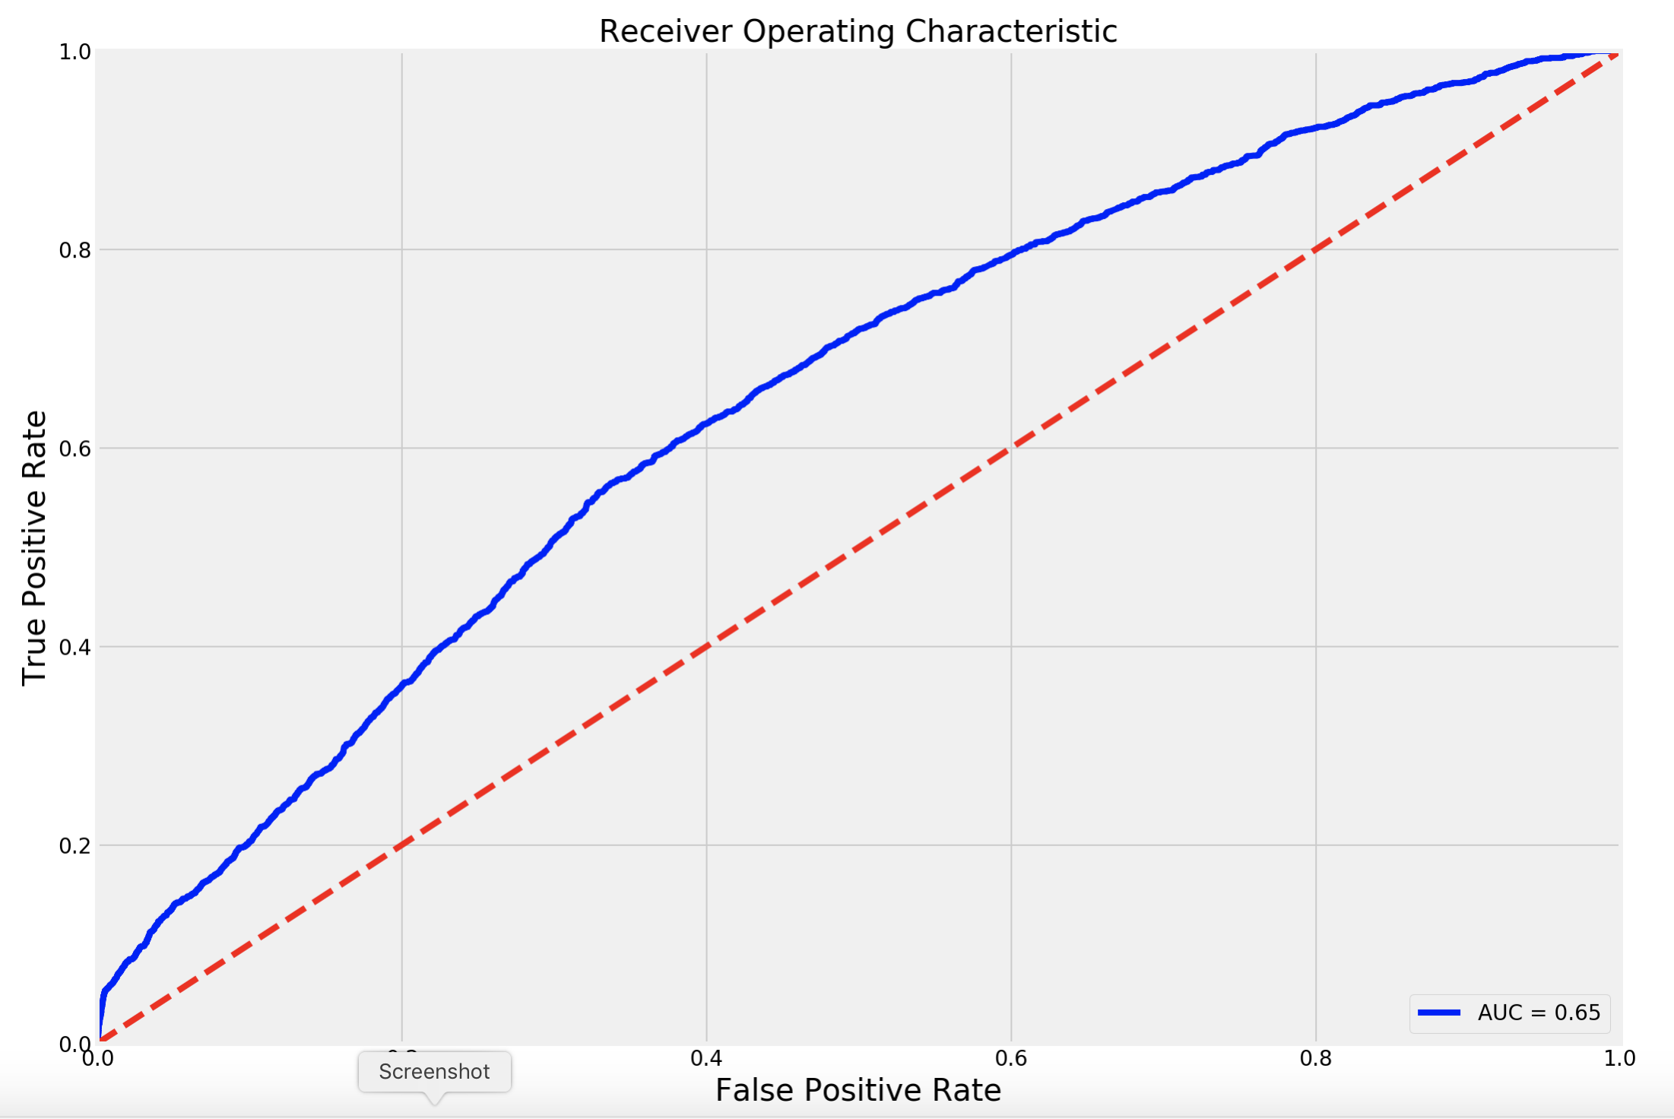
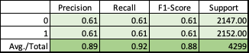
OPTIMIZED MODEL 2: Randomly sampled non-activators and best features logistic regression model
+0.0057
+0.2057 * OEM
-0.0667 * CC
+0.3844 * EverStreamed
+0.2886 * PrevDD
-0.0835 * IncomeOver75k
-0.0978 * DeactNotListening
+0.1774 * DiscountAtDeact
-0.2273 * Tenure
P(Wave_Activation) =
AUC=0.65
N=8,597

Slide 14
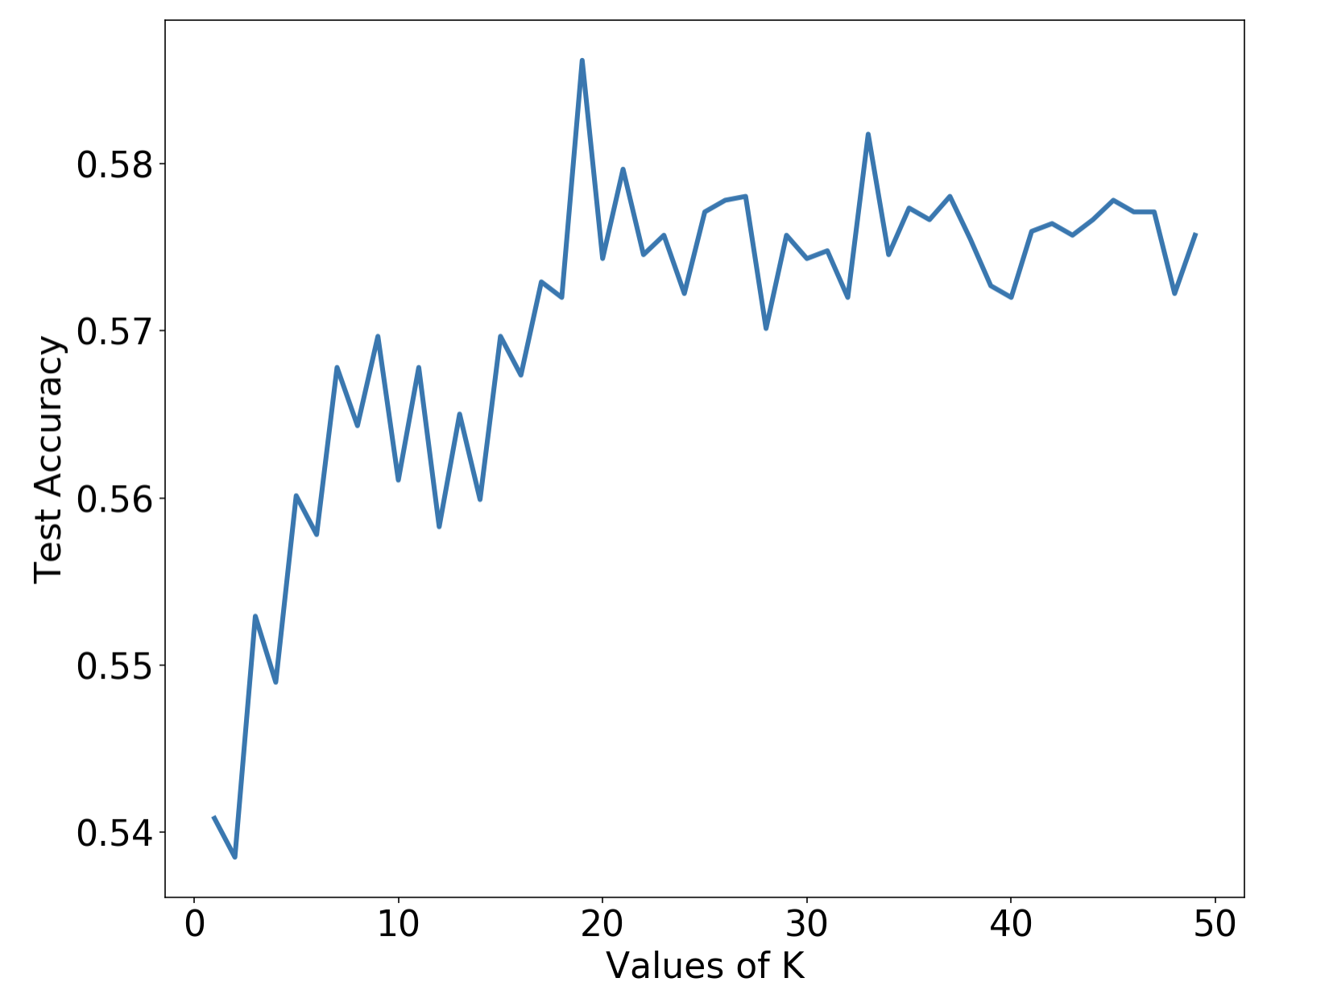
KNN Classification
The following features were included in the KNN:
OEM
CC
EverStreamed
PrevDD
IncomeOver75k
Tenure
Using k=19, our model accuracy is 58.62%

Slide 15
Recommendation:
Based on model accuracy, the best model is the optimized model built using a balanced target and the following variables:
OEM, CC, EverStreamed, PrevDD, IncomeOver75k, DeactNotListening, DiscountAtDeact, Tenure
Logistic Regression yielded a higher accuracy score of 65% over the KNN which was 58%
Recommend adding more numeric variables into the feature selection process to improve model performance.
Model accuracy was the same for a logistic regression with all features versus the optimized number of features and it is always recommended to build as parsimonious a model as possible, so the version with fewer variables is recommended.

